Slide 1

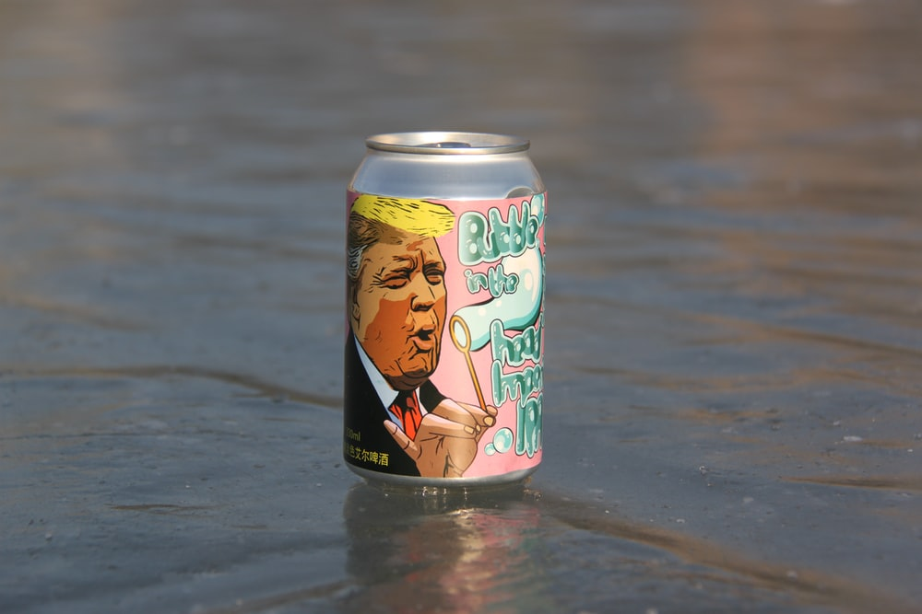


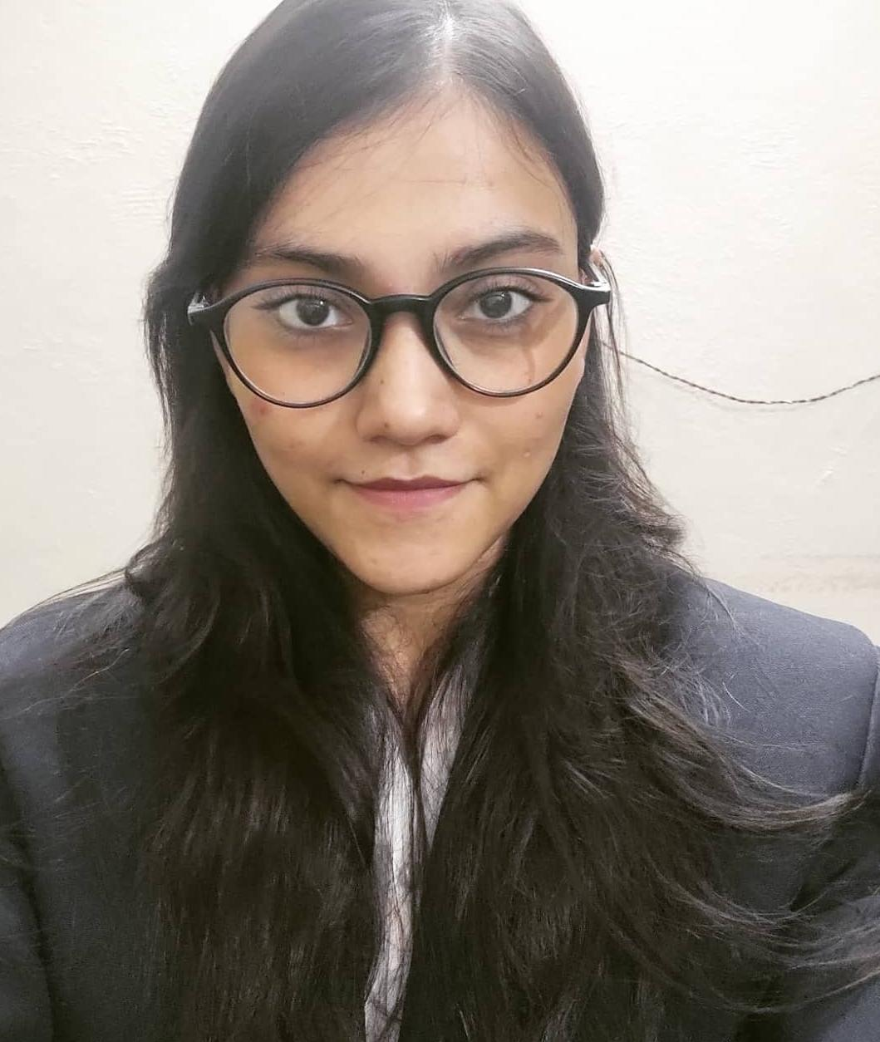
Entrée-preneurship 5.0
Team SORTED
Devesh Sinha Mohit Kiradoo Kajal Gupta
T. A. Pai Management Institute

Slide 2





Resources Used:
Bamboo Fabric Apparel for Kids in a recycled and reusable aluminium can packaging.
Sector Overview
Unrealised demand and cues
Market Sizing
Market value of kid’s apparel in 2018 with estimates for 2023 and 2028
At a CAGR of 10.5%, it is expected that the Kids apparel market will be of 1116 billion Indian Rupees by 2023, which is around 22% of the total Indian Apparel market.
Primary research: (Sample size 45, In-depth interview). We briefed them about bamboo fabric and its features and benefits if used as apparels for kids (age – 0 to 5) and the major findings are as follows
$87.59 Bn
98%
Realised the benefits of bamboo fabric for their kids over other fabrics
Agreed to try bamboo fabric for their kids while considering higher price point. Major concern was health consciousness
Did not know if any brand offering bamboo fabric Kids wear in India
63%
$19.78 Bn
78%
$4.15 Bn
Approach:
TAM -> Total apparel market in India = $87.56 Bn.
SAM -> Kid’s apparel market share is 22.5% of the total market = 87.59*.225 = $19.78 Bn.
SOM -> Sustainable fashion market as of now is 2.1% of the total. Assuming the same % in Kid’s wear it is = 19.78*.21 = $5.15 Bn.
Key drivers of the growing kids apparel market
Rising disposable income of Indian households.
Changing lifestyle in urban areas specially after COVID.
Increasing number of nuclear families in Tier 1 cities.
Rising number of dual income households.
Increased spending on kids apparels in Tier 1 cities.
Sources: Appendix
Common pain points regarding kids apparel offered now
Pure cotton is a myth, brands offering mix cotton i.e. harmful
The Bacteria present in cotton apparels give skin allergy
The best cotton fabric available in the market is very costly
Cotton and other fabric does not absorb odour and stink a lot
Chemicals used in the fabric are harmful for the new-borns

Slide 3
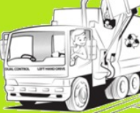
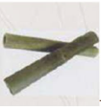
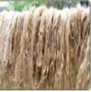
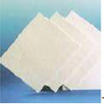
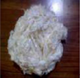
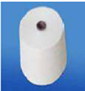


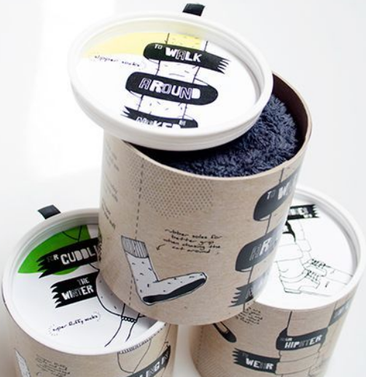
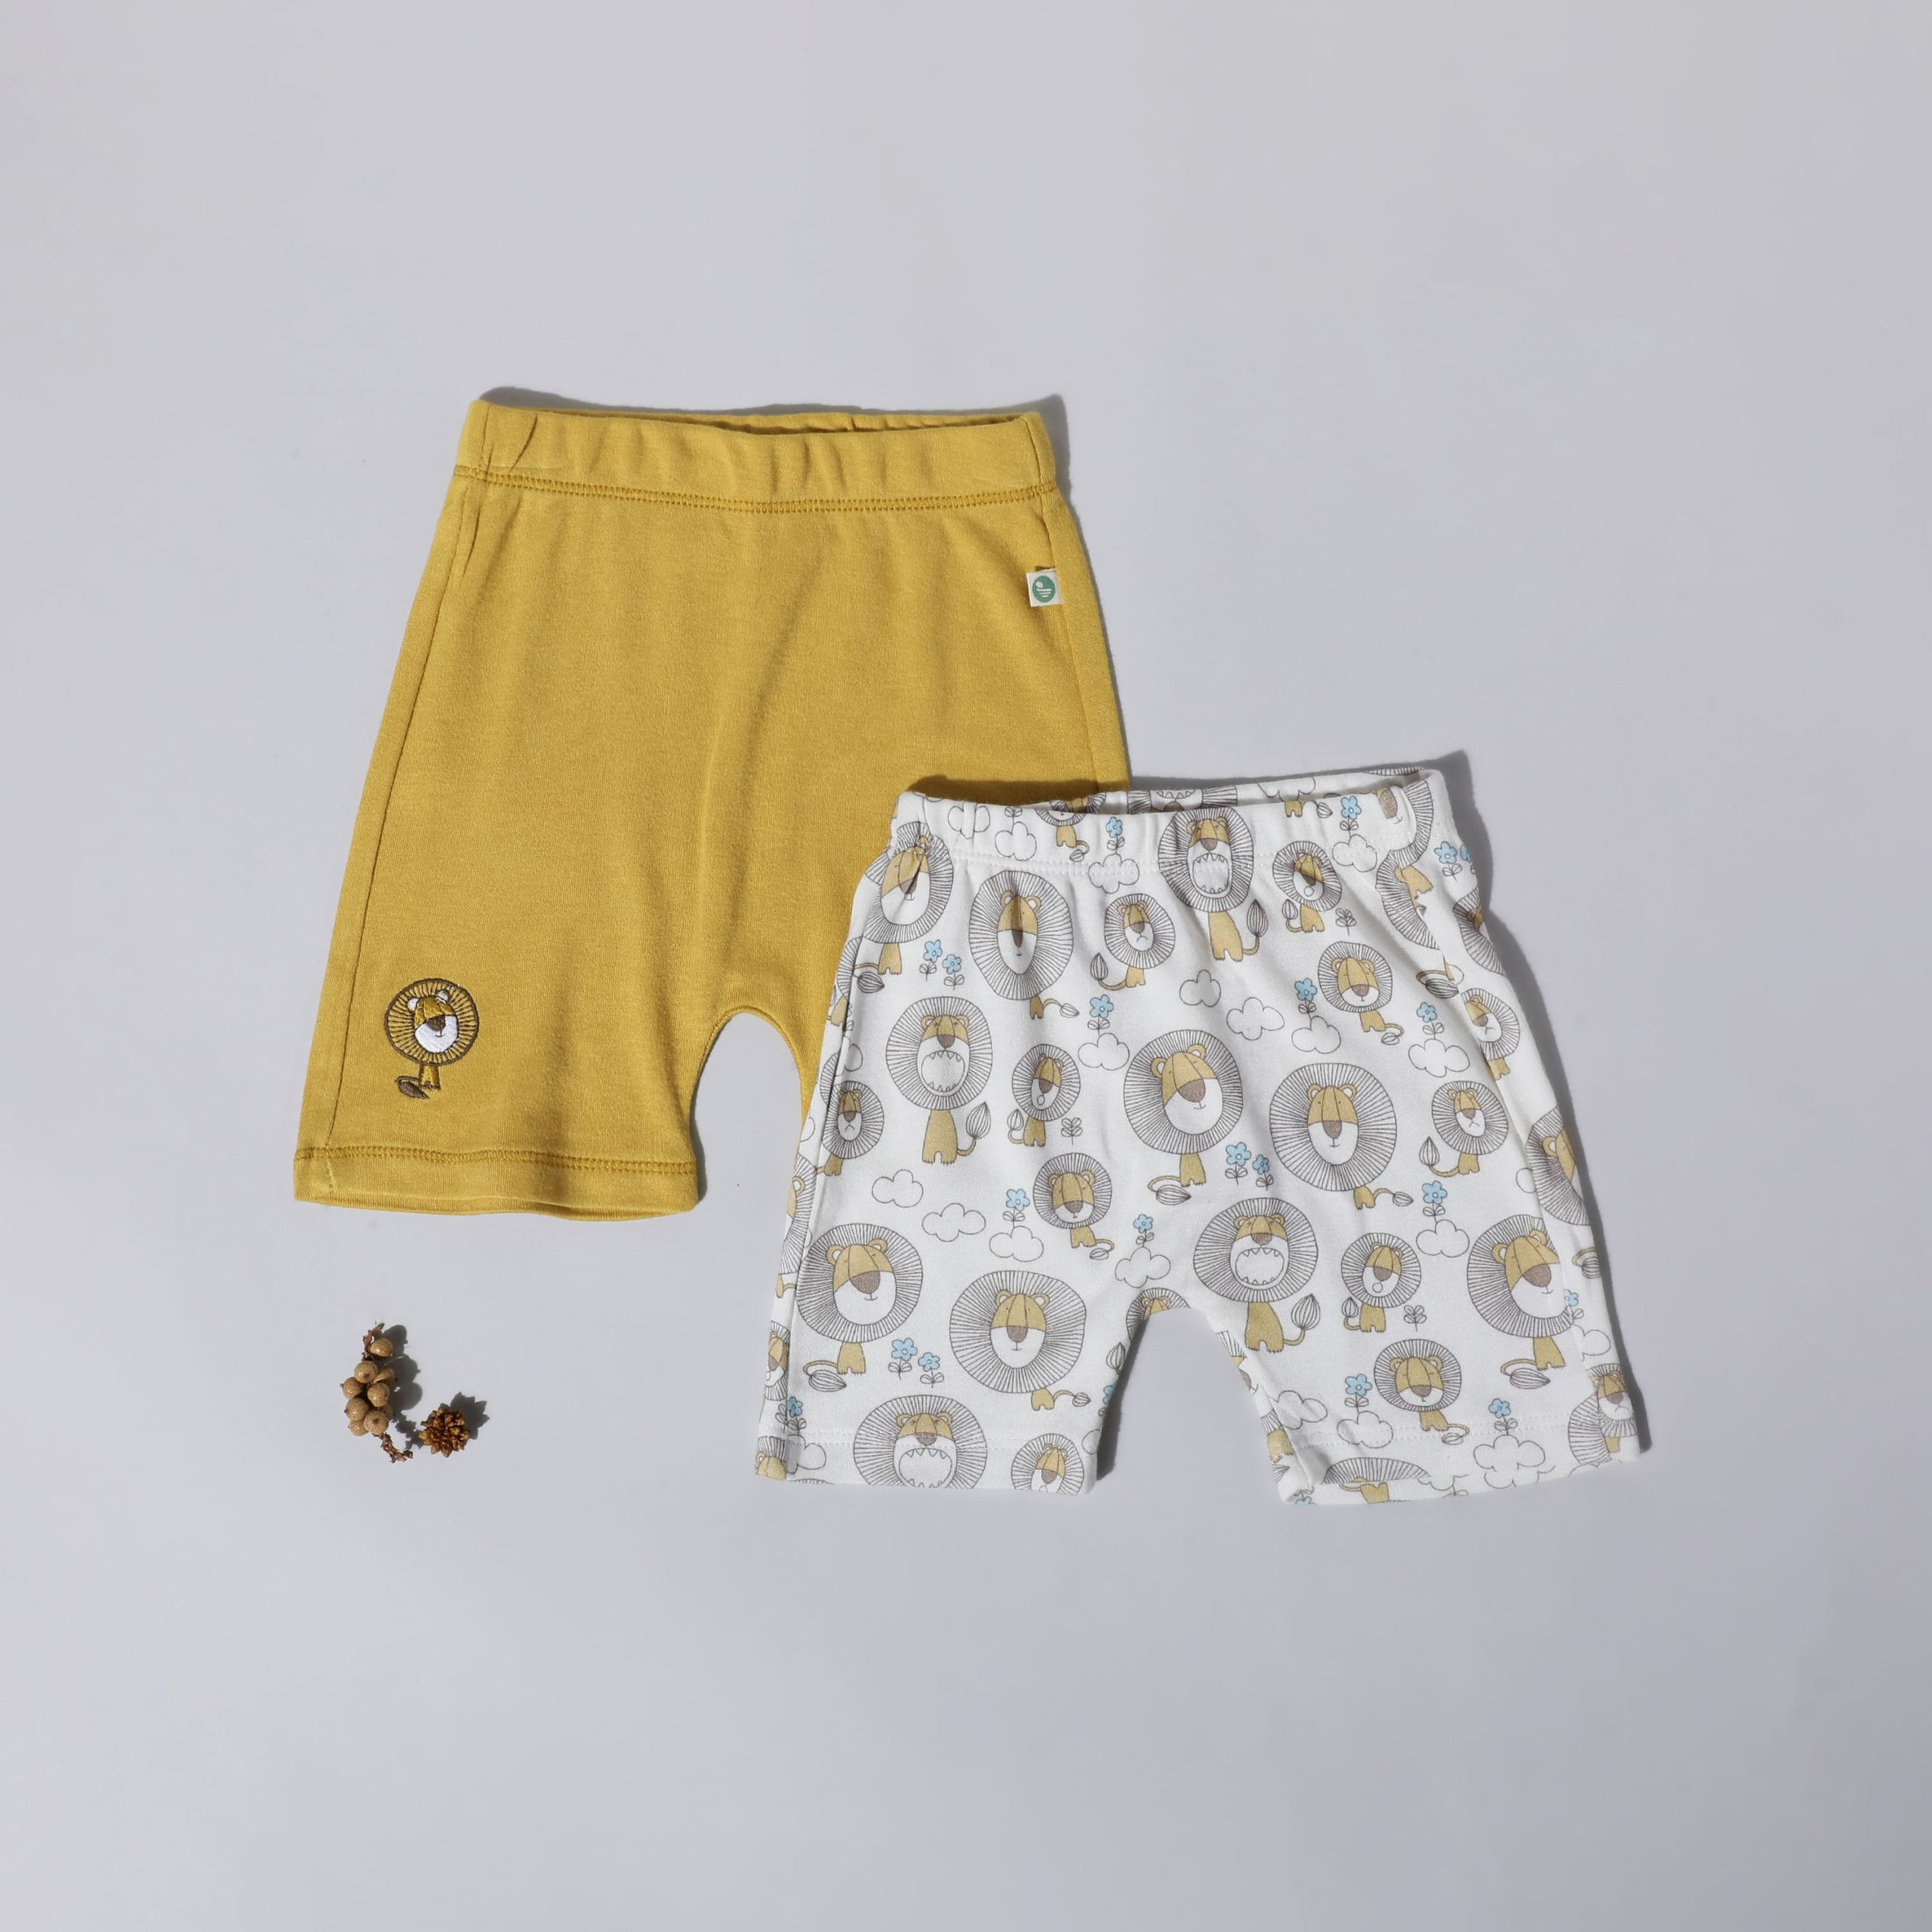


The Golden Circle of our product
Product Journey
Bamboo fabric kid’s apparels in a recycled and reusable aluminium tin can packaging
What?
Best in world bamboo plants extracted using mechanical method and sourcing trash recycled aluminium cans embedding seed paper in them for re-use, completing the circular economy
Collection of aluminium can
Raw bamboo
Processed into thick pulp
Processed into sheet
Processed into sheet
Spun into yarn
How?
Bamboo fabric has various advantages over other fabrics such as – Eco Print, Built in temperature control, chemical free, hypoallergic, UV Resistant and is one of the most sustainable plants for fabric
Why?
Cleaning & melting
Rolling
Recycled with seed paper
Stitched Kid’s wear
Woven bamboo fabric
OUR PRODUCT
Key Partners
Key Resources
Our Customer Persona
Raw Material supplier: Bamboo , scraped tin ,organic seeds
Scrape aluminum Supplier From Morbi, Gujarat, India
Aluminum tin packaging manufacturers and designers
Retailers : Gini & Jony, Lilliput, Max, GAP etc
Ecommerce partners : amazon, flipkart, theyarnbazaar, Itsy bitsy
Corporate social responsibility organization
Bamboo yarning partners
Promotion and branding partners
Technology partner
Certifier : FSC certification, GOTS certification, ISI 9001:2015
Legal advisors, Audit partners,Logistics
Production space and warehouse on rent
Research and development space
Manufacturing tools on rent
Aluminium subcontractors
Personal website
high-tech software
Capital
Individual resources :
  In house tailors
  Machinery/equipment
  Staff : Employee
Kajal is a 28 years old mother of a 6 months old baby boy staying in the city of Mumbai. She works as a consultant at CommScope, and her CTC is 14 Lpa her husband earns 15 Lpa. She has become very health conscious specially after COVID and has kept the utmost care of her baby during pregnancy (Ex – consumed organic and sustainably produced chemical free fruits and vegetables, got treated by the best of gynaecologists). She is very conscious about the food; baby products and clothes used for her baby boy and has high engagement while buying them. She has an average purchase of 5 order per month from Ecommerce and visits the nearby mall every weekend.
Value Proposition:
3x softer than cotton
Enablers of sleep
Safe as a mother’s womb
A conscious choice

Slide 4



Estimating revenue generation for the first year
Generating revenue from 3 distribution channels
Age: 25-35 years
Family Income > 1.5lacs per month
Assumption: 8% CAGR
25-30
31-35
Asset-light cost structure for lower fixed costs
55 mn
50 mn
52 mn
48 mn
Total pop: 105 mn
Total pop: 100 mn
As obtained from secondary sources, an average household in India has 4 members
Households:26.25mn
Households:25mn
Only 2% of these households have family income above 1.5 lacs per month
ROI based cost allocation for each of the departments
TG Households:5.25 lac
TG Households:5 lac
Considering only 2% of these households buy our products
The total amount is allocated to each department based on Return on Investment(ROI) method. Sales and marketing are two the major functions for increasing the reach and boost sales of the product. Hence, these are allocated higher percentages. In the future, this allocation can be varied depending on the return obtained from the investment.
Customers: 10500
Customers: 10000
Considering Average Ticket Price: ₹ 500
Revenue: ₹1.025 cr
The unutilised allocation to each department is to be used to scale up the business, on multiple locations/geographies.

Slide 5
APPENDIX: Secondary Research Sources
https://www.businesswire.com/news/home/20210112005540/en/India-Kids-Wear-Market-2021-to-2026---by-Gender-Category-Season-Sector-Distribution-Channel-and-Region---ResearchAndMarkets.com
https://www.fortunebusinessinsights.com/kids-apparel-market-104630
https://www.sutlejtextiles.com/blogs/blog-post.php?id=D11
https://www.globenewswire.com/en/news-release/2021/01/11/2156393/28124/en/Insights-on-the-Kids-Wear-Indian-Market-to-2026-Featuring-Shoppers-Stop-Arvind-Fashions-and-Lilliput-Kids-Wear-Among-Others.html
https://www.statista.com/statistics/730996/kid-s-apparel-market-size-india/
https://naturefabstore.com/bamboo-industry-in-india-cultivation-and-export/
https://www.fibre2fashion.com/industry-article/3842/benefits-of-bamboo-fabric
https://fashionandtextiles.springeropen.com/articles/10.1186/s40691-015-0054-5
https://theprint.in/opinion/india-can-go-the-khadi-way-to-realise-its-bamboo-potential-cut-imports-from-china/735470/
https://www.panaprium.com/blogs/i/bamboo-fabric
https://softsensbaby.com/blogs/from-softsens/bamboo-fabric-for-babies#:~:text=Bamboo%20fabric%20is%20also%20hypoallergenic,such%20as%20wool%20or%20hemp.
https://www.researchgate.net/publication/335836217_A_Study_on_Parents'_Opinion_and_Awareness_about_Kidswear
https://www.babydestination.com/fabrics-avoid-for-babies
https://www.upchoose.com/blog/why-is-organic-clothing-better-for-babies
https://www.organictextiles.com/blogs/news/organic-cotton-vs-bamboo#:~:text=Both%20are%20soft%2C%20eco%2Dfriendly,%2C%20delicate%2C%20and%20more%20breathable.
https://www.statista.com/outlook/cmo/apparel/india#revenue
https://www.ieltstrainingtips.com/the-diagram-describes-the-recycling-process-of-aluminium-cans-2/

Slide 6
APPENDIX: Fixed costs and Employee salaries (assumptions and calculations)

Slide 7
APPENDIX: Variable costs and ROI based calculations for each department

